Slide 1
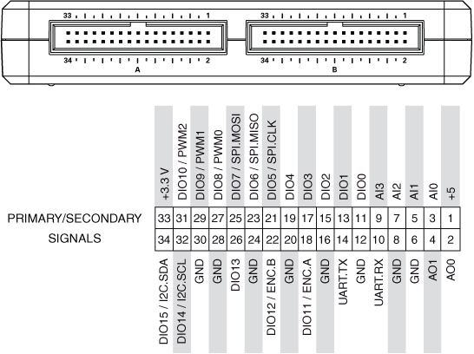
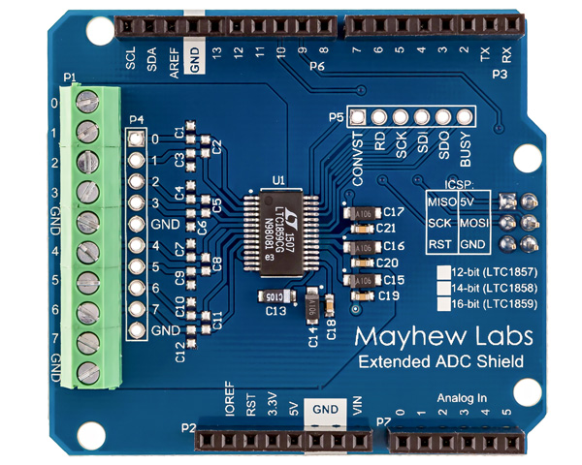
NI- My RIO
Pin 8
Leave RST
unconnected
Pin10 to GND
Voltage
Input
you desire
to read

